Slide 1
Alternative Energy: Wind Power
By Joon Sang Yoon

Slide 2
Wind Power
- Converting wind energy into a useful form of energy
- Transformation of Kinetic Energy (of wind with velocity) into mechanical or electrical energy that can be harnessed for practical use
- Generates about 2.5% energy worldwide
Notes:
The wind power is basically the conversion of an wind energy into a useful form of energy. To be specific, it is a transformation of Kinetic Energy of wind into mechanical or electrical energy that can be harnessed for practical use. About 2.5% of the energy is generated by wind power worldwide. This equation explains how the kinetic energy can be calculated. Since, we just went over the math or derivation of this equation, I’m not going to repeat same thing.

Slide 3
History
The first recorded windmills that were created are from China in 1219
During 17th century, hundreds of windmills were created in Europe and America
Up to 19th century, windmills were used to produce mechanical power to do tasks such as pumping water and grinding stones
1888: the first electricity producing windmills invented
Today wind turbines are considered as one of possible alternative energy (fastest growth rate among alternative energy sources)
Notes:
The first recorded windmills in history is from China in 1219. It is significant record because China built those windmills along the coast line, which have stronger and steadier wind throughout the day and night.

Slide 4
Complicated Structures
Notes:
Umm…. So this is rotor blade. This is gear box and that is generator… I’ll explain further details with much easier picture.

Slide 5
Basic Principle
Notes:
Both windmill and wind turbine has the same basic principle. So this is how the wind can be converted into electricity. STEP 1: Moving air pushes against the blades of the turbine, which are tilted to the direction of the wind. This makes the blades spin. In the process, some of the kinetic energy of the moving air is transformed into the mechanical energy of the spinning blades. (The wind still has some kinetic energy as it flows away from the turbine.)
STEP 2: The shafts and the gears inside the gear box transfer the mechanical energy of the turbine to the generator. (The gears make the drive shaft to the generator spin faster than the shaft connected to the blade hub.)
STEP 3: The generator transforms mechanical energy into electrical energy.
Then, the electricity goes through substations to be stored or used in households or many other places.

Slide 6
Ideal location for wind turbine
Notes:
Wind turbines must, of course, be located where there are steady strong winds - though not so strong they would damage the turbines.
They work at their greatest possible energy efficiency, however, when they operate in 'smooth' air - that is, when the air particles are moving in the same direction and not whirling around and moving in different directions.
Ideal sites for wind turbines therefore are:
The places where wind turbines are away from obstructions such as forests, towers and rocky outcrops. (These would cause the air to whirl around.)
At the highest point possible since the speed goes up as the height increases.
So, The best place to locate the windmill would be on the top of a smooth hilltop, where the wind can concentrate and increase in speed.

Slide 7
Sankey Diagram: Efficiency
Notes:
A sankey diagram is one that shows the transformations of energy as it is processed, in this case through a wind generator. Betz law, simply put, is a theory by the German physicist Albert Betz (in 1919) that states the maximum amount of energy that can be developed from a wind generator. According to the law, none of the wind generator can be more than 59.3% efficient. The diagram above shows that several more energy losses, such as electrical generator losses and substation losses occur as the wind's kinetic energy is ultimately transformed into electrical energy. Therefore, about 45% of the Kinetic Energy received by the blade would be converted to the electricity. Therefore, considering the fact that the not all of kinetic energy of air is being passed to the blade, the final electricity generated would be lot less than kinetic energy that the air possesses.

Slide 8
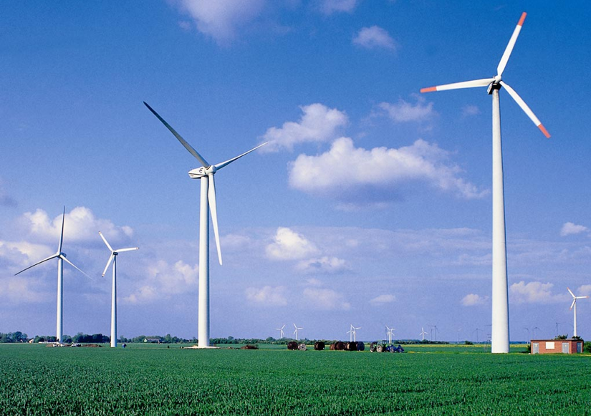
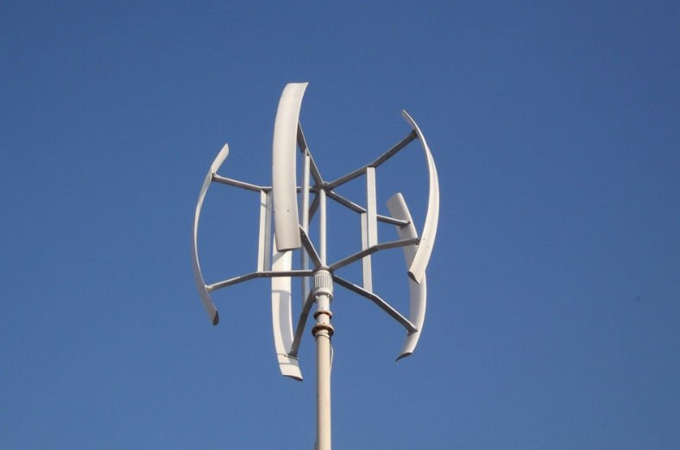
Types
Windmill
Wind Turbine (HAWT, VAWT)
Notes:
As I showed in explaining the general history of wind power. These are two big types. The first picture is the windmill, which produces mechanical energy and directly uses it by machinery, such as pumping water or grinding stones. The picture on the right is called wind turbines and they also produce mechanical energy but convert it to electricity. The one at the top is horizontal axis wind turbine which the blades rotate parallel to the ground. The one at the bottom is vertical axis wind turbine that the blades rotate perpendicular to the ground.

Slide 9
HAWT
Notes:
Horizontal axis wind turbines, also shortened to HAWT, are the common style that most of us think of when we think of a wind turbine. A HAWT has a similar design to a windmill, it has blades that look like a propeller that spin on the horizontal axis.
Horizontal axis wind turbines have the main rotor shaft and electrical generator at the top of a tower, and they must be pointed into the wind. Small turbines are pointed by a simple wind vane placed square with the rotor (blades), while large turbines generally use a wind sensor coupled with a servo motor. Most large wind turbines have a gearbox, which turns the slow rotation of the rotor into a faster rotation that is more suitable to drive an electrical generator.
Since a tower produces turbulence behind it, the turbine is usually pointed upwind of the tower. Wind turbine blades are made stiff to prevent the blades from being pushed into the tower by high winds. Additionally, the blades are placed a considerable distance in front of the tower and are sometimes tilted up a small amount.
Downwind machines have been built, despite the problem of turbulence, because they don't need an additional mechanism for keeping them in line with the wind, and because in high winds, the blades can be allowed to bend which reduces their swept area and thus their wind resistance. Since turbulence leads to fatigue failures, and reliability is so important, most HAWTs are upwind machines.

Slide 10
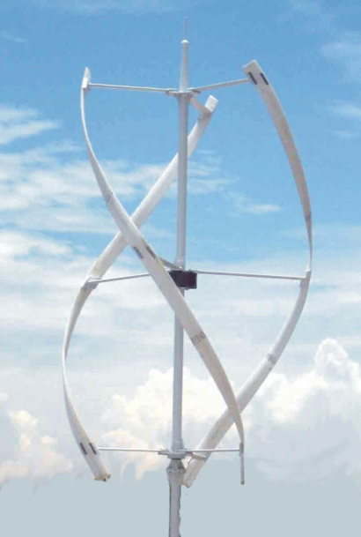
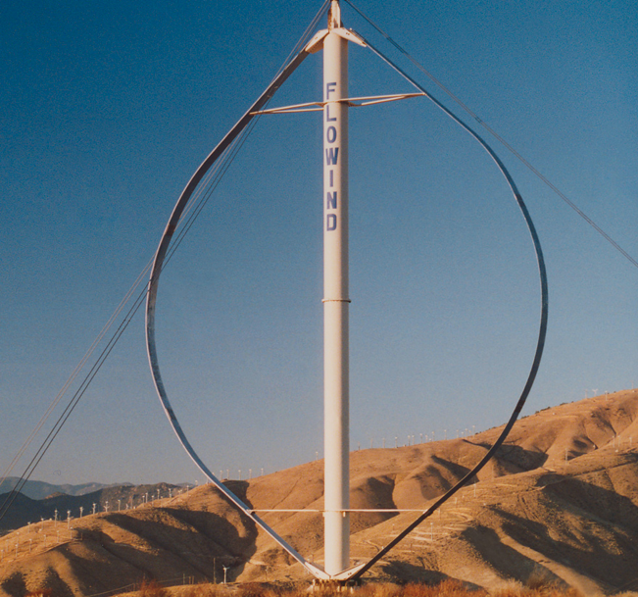
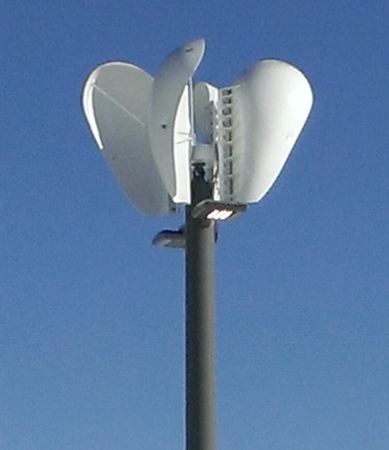
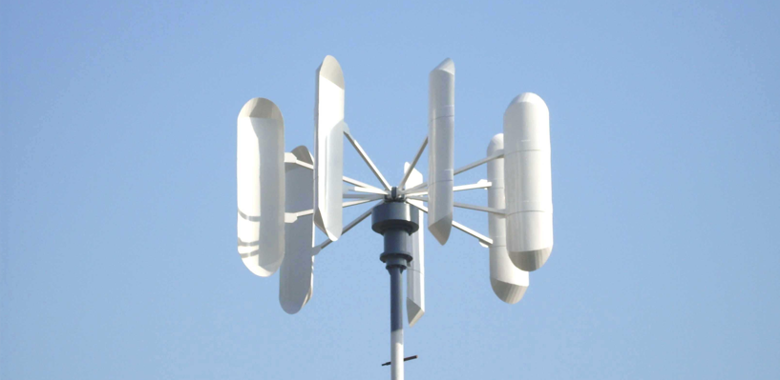
VAWT
Notes:
Vertical axis wind turbines, as shortened to VAWTs, have the main rotor shaft arranged vertically. The main advantage of this arrangement is that the wind turbine does not need to be pointed into the wind. This is an advantage on sites where the wind direction is highly variable or has turbulent winds.
With a vertical axis, the generator and other primary components can be placed near the ground, so the tower does not need to support it, also makes maintenance easier. The main drawback of a VAWT generally create drag when rotating into the wind.
It is difficult to mount vertical-axis turbines on towers, meaning they are often installed nearer to the base on which they rest, such as the ground or a building rooftop. The wind speed is slower at a lower altitude, so less wind energy is available for a given size turbine. Air flow near the ground and other objects can create turbulent flow, which can introduce issues of vibration, including noise and bearing wear which may increase the maintenance or shorten its service life. However, when a turbine is mounted on a rooftop, the building generally redirects wind over the roof and this can double the wind speed at the turbine. If the height of the rooftop mounted turbine tower is approximately 50% of the building height, this is near the optimum for maximum wind energy and minimum wind turbulence.

Slide 11
Advantages
Wind is free
Does not cause green house gases as it produces electricity
Needs small portion of land
Isolated areas that are not connected to the electricity power grid can use wind turbines to produce their own supply
Arranges a lot in a size – can be used for one household to whole city

Slide 12
Disadvantages
The strength of the wind is inconstant – leads to inconstant produce of electricity
Even though it takes only small part of a land, it can block the views and change the landscape
It can be noisy as a car travelling 70miles per hour.
With a 25% capacity factor, a 1.5-MW wind turbine (100m tall) would produce (1.5 MW × 365 days × 24 hours × 25% = 3,285 MWh =) 3,285,000 kWh and it would allow about 330 households to use it. Thus, it will need huge wind power farm to supply a big city or even a nation.

Slide 13
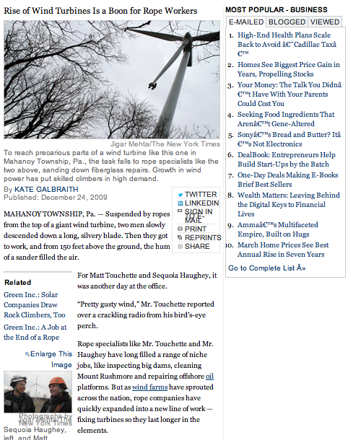
News#1
Increases the employment rate
Notes:
The jobs involve cleaning the blades when it gets struck by lightning or damaged by ice. Since the blades are made of fiberglass, and repair jobs may involve taking out the old fiberglass and putting in new material, which then needs to be sanded down for smoothness. As this article from new york times shows, the effects on our society is that it creates jobs that lead to increase in employment rate and ultimately lead to growth in economics.

Slide 14
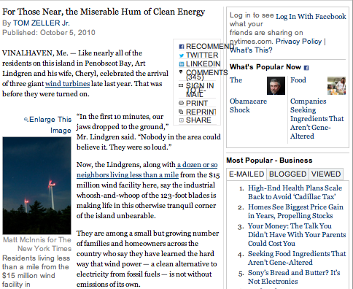
News#2
Noisy attracts complains
Notes:
In Vinalhaven, Maine, the giant wind turbine farms were planted. At, firs, the residents liked because they could save energy. But now, a year later, they are complaining about the noisy that it makes during the days and nights. While, the wind turbine has positive effects to our society, it also has its downside such as noisy that turbine makes whenever there is wind to rotate the blade.

Slide 15
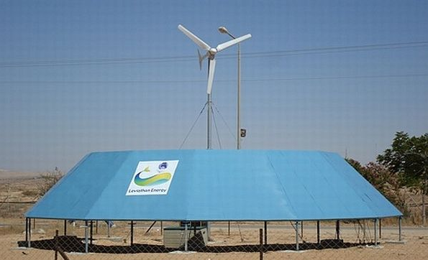
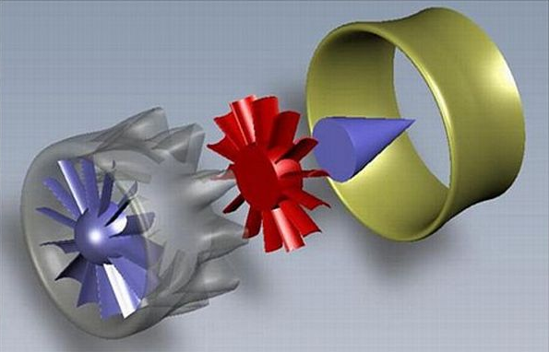
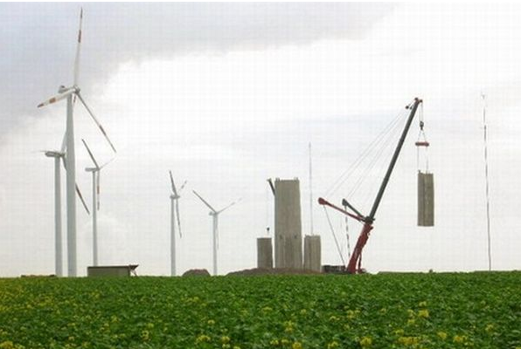
Advancements in future
Notes:
Leviathan Energy is an ideal way to increase the efficiency of a wind turbine. The best part is that there is no need to increase the size of the turbine. This innovation is developed by Daniel Farb, the CEO of Leviathan Energy. He has named this innovation “Wind Energizer” which is capable of increasing wind energy output by 30 percent. The idea was to modify the environment around the turbine to ensure that highest velocity winds hits the blade rather than increasing the blade size of the turbine. So a donut shape structure was formed in such shape and dimensions such that highest velocity wind hits the blade. The break even for erecting this structure has been estimated to be around four to five years, thus, making it an irresistible deal.
2. Another advancement that we can look forward in our future is simply increasing its height. Conventionally people used to increase the blade size to increase the turbine efficiency which soon turned out to be an expensive option with limited availability of space. However, with this technique one can boost the efficiency of the turbine by 20 percent. This is surely a cost-effective method that will continue to offer its benefits for a longer period of time without incurring considerable amount of money.
3. Lastly, Jet-inspired wind turbine. Its design can generate electricity at half the cost if a conventional wind turbine. Drawing inspirations from jet engines, this design has been developed to minimize the wind losses. Conventionally in a wind turbine, half of the wind energy is spent on rotating the blades while the other half in generating electricity. This wind turbine design effectively increases the speed of the wind when it leaves the blade, thus, increasing its output. With this innovative design one can have the same amount of electricity generated by a turbine of half the size. So we have can now install more turbines per acre of land, thereby, increasing the efficiency manifold. The shroud used in this design facilitates more air to be sucked in ensuing increased power output.

Slide 16
Conclusion
Kinetic Energy (velocity of wind) converted to electricity through generator
Has advantages but also disadvantages
Has lots of room to advance

Slide 17
Thanks

Slide 18
Citation
http://www.aweo.org/windmodels.html
http://greenliving.nationalgeographic.com/alternative-energy-wind-electricity-2191.html
http://www.nytimes.com/2009/12/25/business/25climb.html
http://www.nytimes.com/2010/10/06/business/energy-environment/06noise.html?_r=0
http://www.umass.edu/windenergy/publications/published/communityWindFactSheets/RERL_Fact_Sheet_2a_Capacity_Factor.pdf
http://energy.korea.com/archives/11357
http://inhabitat.com/eddy-gt-wind-turbine-is-sleek-silent-and-designed-for-the-city/
http://epa.gov/climatestudents/solutions/technologies/wind.html
http://www.mechanicalengineeringblog.com/tag/wind-turbines/

Slide 19
Citation (MLA)
"Aweo.org :: Industrial Wind Energy Opposition." AWEO. N.p., n.d. Web. 28 May 2013.
"Green Living | National Geographic." Green Living on National Geographic. N.p., n.d. Web. 28 May 2013.
Shear, Michael D. "Obama and Christie View Recovery on Jersey Shore." The New York Times. The New York Times, 29 May 2013. Web. 28 May 2013.
"University of Massachusetts Amherst." University of Massachusetts Amherst. N.p., n.d. Web. 28 May 2013.
"Energy Korea." Energy Korea. N.p., n.d. Web. 28 May 2013.
"Inhabitat - Sustainable Design Innovation, Eco Architecture, Green Building." Inhabitat - Sustainable Design Innovation, Eco Architecture, Green Building. N.p., n.d. Web. 28 May 2013.
"US Environmental Protection Agency." EPA. Environmental Protection Agency, n.d. Web. 28 May 2013.
"Mechanical Engineering." Mechanical Engineering RSS. N.p., n.d. Web. 28 May 2013.

